Slide 1

Amazon Revenue Analysis using MySQL and Power BI
Analysed and Visualized by: Farwah Hasnain

Slide 2
Amazon Revenue Analysis - Summary
I performed a comprehensive Amazon Revenue Analysis using a dataset of more than 89,000 records. The analysis was carried out through MySQL for data preparation and transformation, and later visualized in Power BI for insights and interactive reporting.
Key Steps & Approach
Data Preparation (MySQL):
Cleaned and structured the dataset containing fields such as Product Category, Product Description, Price, Number of Reviews, Shipment, and Order Date.
Created calculated columns and aggregated metrics (e.g., revenue, orders, review counts) for downstream analysis.
KPI Development (Power BI): Designed DAX measures to capture key business metrics, including:
Total Revenue and Total Orders, Average Order Value (AOV), YTD, MTD, and QTD Sales, Revenue Growth (MoM %), Customer Engagement Metrics (e.g., reviews per product, review-to-sales ratio)
Visualization (Power BI Dashboard):
Revenue Trends: Line & area charts for sales over time (daily, monthly, quarterly).
Category Insights: Bar and column charts for revenue by product category.
Customer Behavior: Orders by weekday vs. weekend (reviews vs. revenue).
KPI Cards: Quick-glance metrics for decision-makers.
Comparisons: MoM and YTD growth visualized using combo charts and cards.

Slide 3
Amazon Revenue Analysis - Summary
Outcomes
The dashboard provided a clear view of sales performance, seasonality, and customer engagement patterns. Key insights included:
Identification of top-performing product categories.
Trends in order volumes across weekdays vs. weekends.
Customer engagement levels through reviews and revenue per review.
Growth tracking with MoM and YTD performance indicators.

Slide 4
Purpose Of the Queries – Overall Analysis Flow
1. Measure Overall Business Performance
Total Revenue → Establishes the overall sales value in dollars, forming the baseline metric.
2. Identify Top-Performing Areas
Revenue by Product Category → Highlights which categories drive the most revenue. Revenue Contribution % → Shows each category’s share of the total pie. Number of Orders per Category → Reveals popularity by order volume (not just revenue). Top 5 Products by Sales → Pinpoints star products.
3. Understand Customer Engagement
Reviews-to-Sales Ratio → Measures how engaged customers are by category.
4. Spot Trends and Seasonality
Monthly Sales Trend → Tracks performance month-by-month. Sales by Month (descending) → Identifies peak revenue months. Month-over-Month Sales Growth → Shows acceleration or slowdown trends over time.
5. Analyze Shopping Behavior
Weekday vs Weekend Orders → Compares order volume patterns. Weekday vs Weekend Revenue → Shows spending behavior differences by day type.

Slide 5
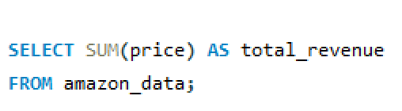
Total Revenue
Business Question Answered:
What is the overall revenue generated?

Slide 6
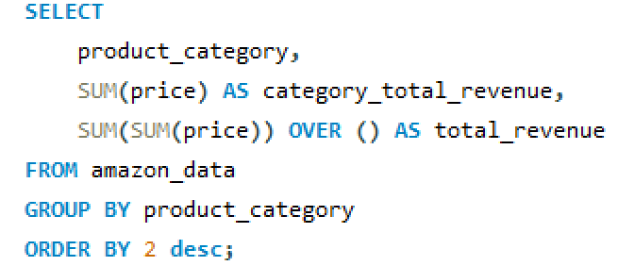
Revenue by Product Category
Business Question Answered:
Which categories generate the most revenue?

Slide 7
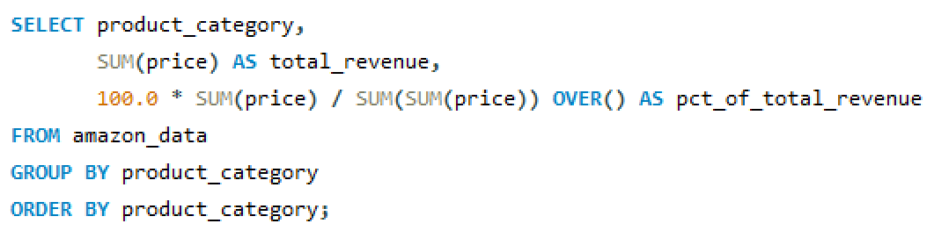
Revenue Contribution By Category
Business Question Answered:
How much does each category contribute to total revenue?

Slide 8
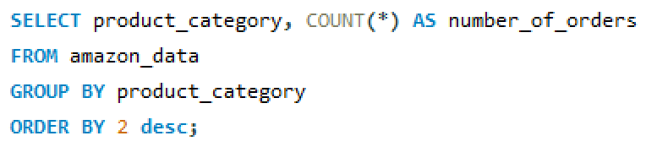
Number of Orders Per Category
Business Question Answered:
Which categories are the most popular by order volume?

Slide 9
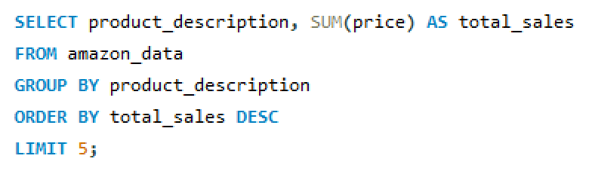
Top 5 Products by Sales
Business Question Answered:
Which products are top sellers?

Slide 10
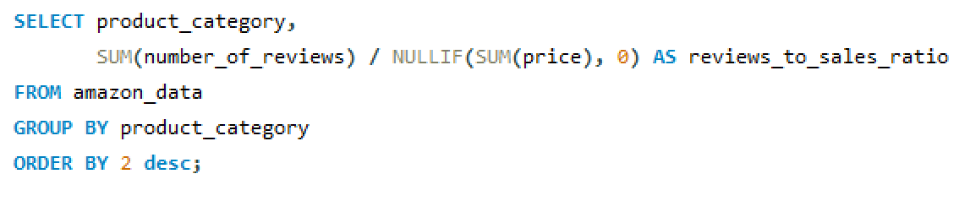
Customer Engagement: Review to Sales Ratio
Business Question Answered: Which categories have the most engaged customers?

Slide 11
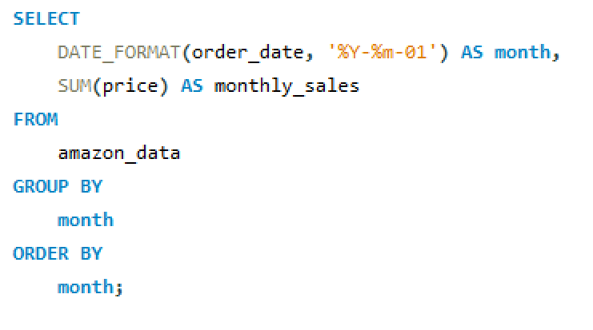
Monthly Sales Trend
Business Question Answered: How do sales change over time by month?

Slide 12
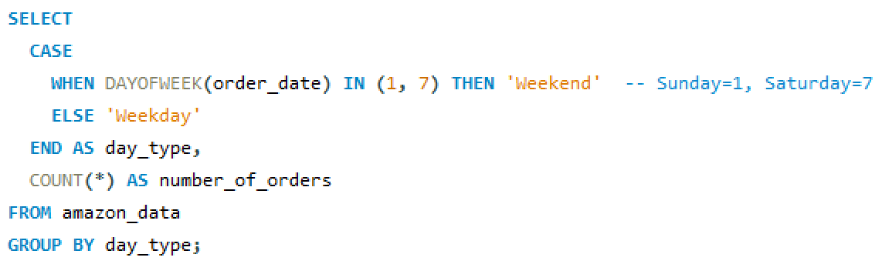
Weekend vs Weekday Orders
Business Question Answered: Are customers more active on weekends or weekdays?

Slide 13
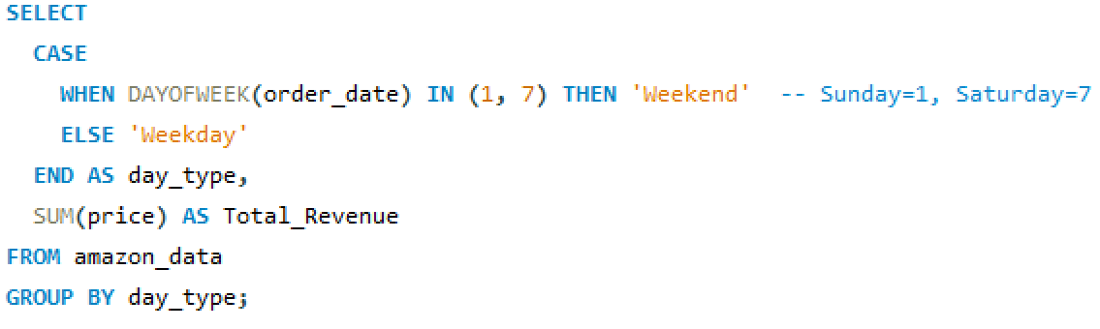
Weekend vs Weekday Revenue
Business Question Answered: Does revenue differ significantly between weekdays and weekends?

Slide 14
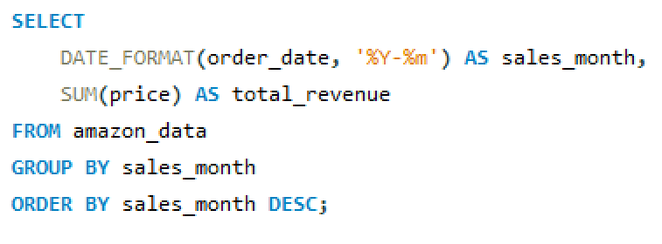
Sales by Month
Business Question Answered: Which months had the highest revenue?

Slide 15
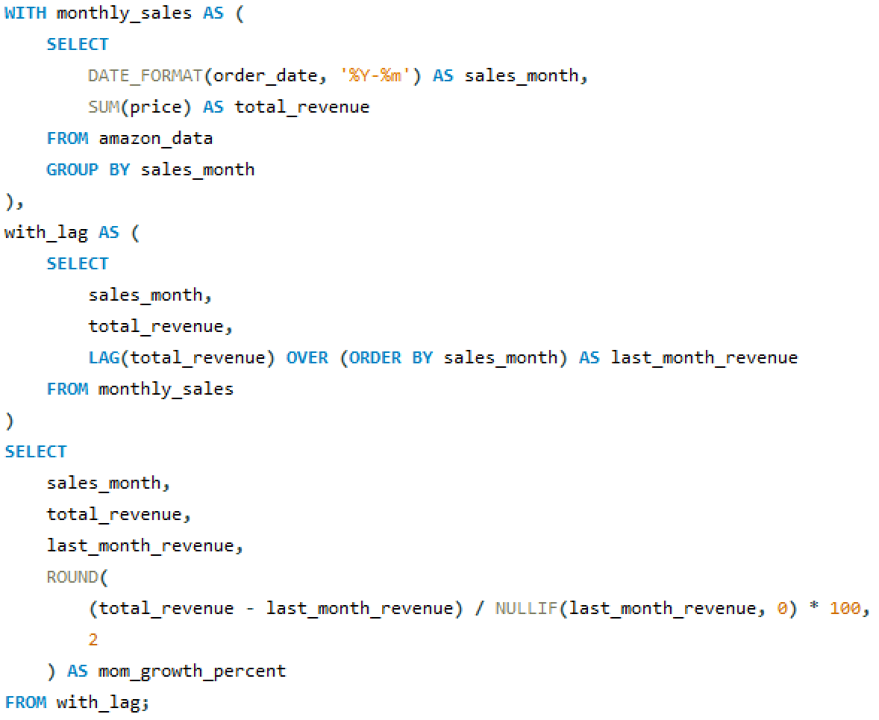
Month-over-Month Sales Growth
Business Question Answered: What is the growth rate of revenue compared to the previous month?

Slide 16
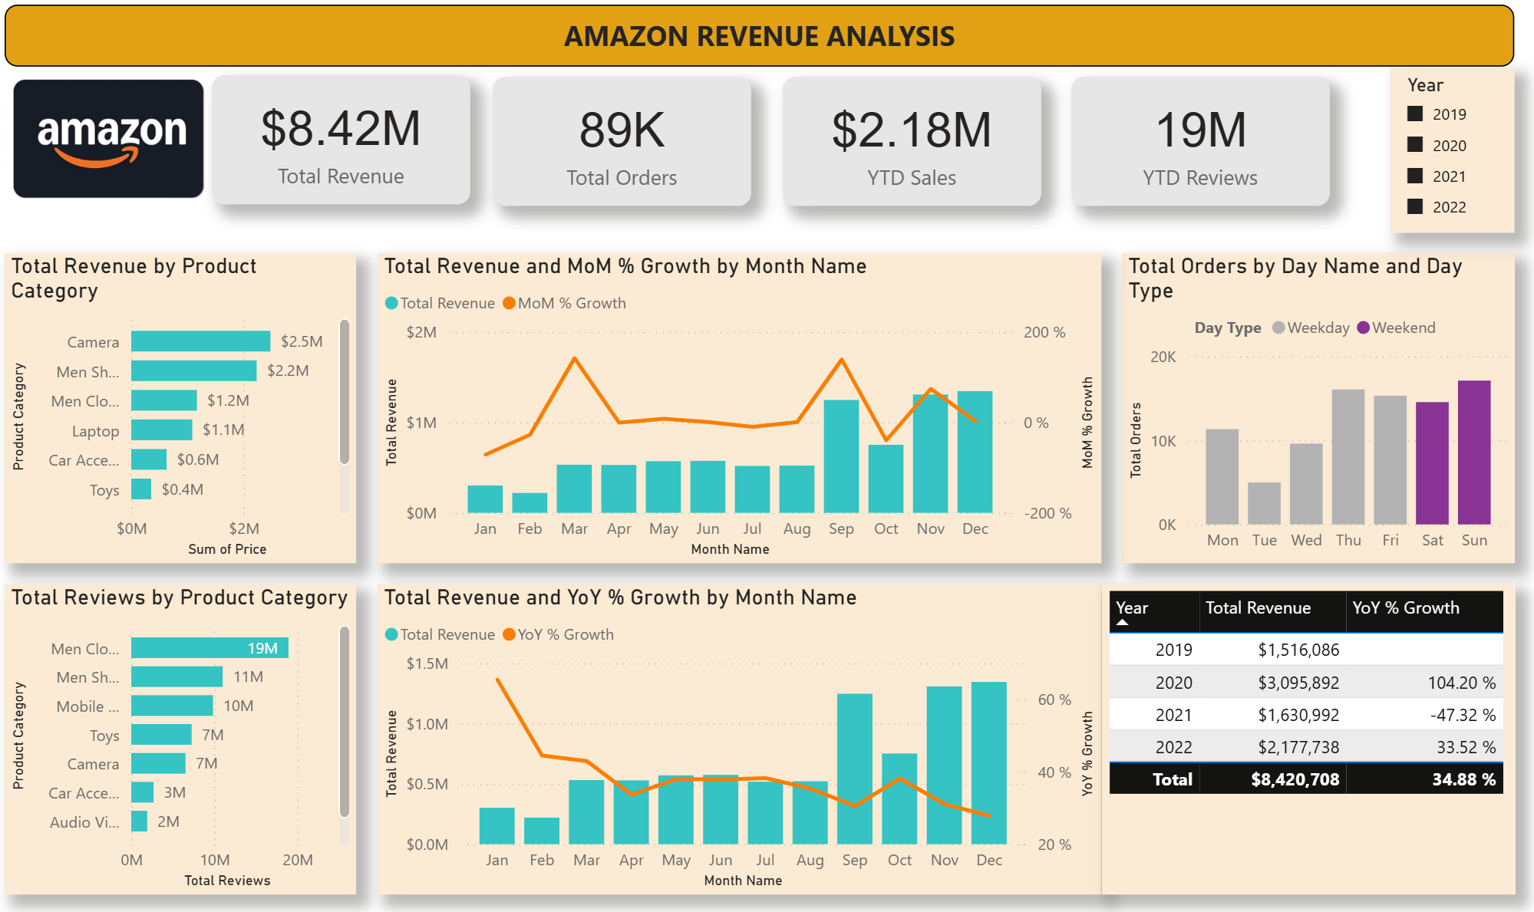
Power BI Dashboard

Slide 17
Conclusion
👉 Overall, the Amazon Revenue Analysis delivered an end-to-end data story — from raw data in MySQL to interactive business intelligence dashboards in Power BI — helping uncover actionable insights from a large dataset of 89k+ transactions.

